Slide 1
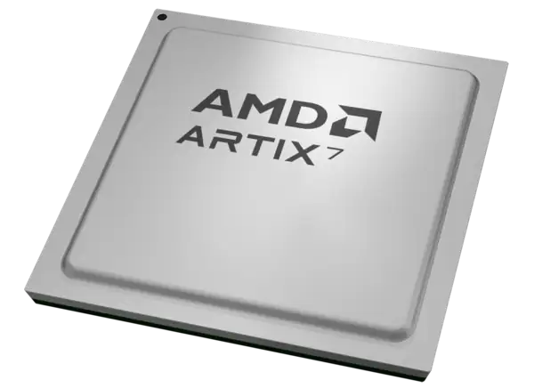
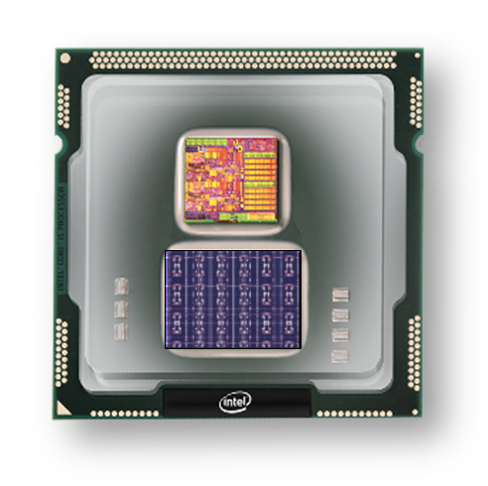
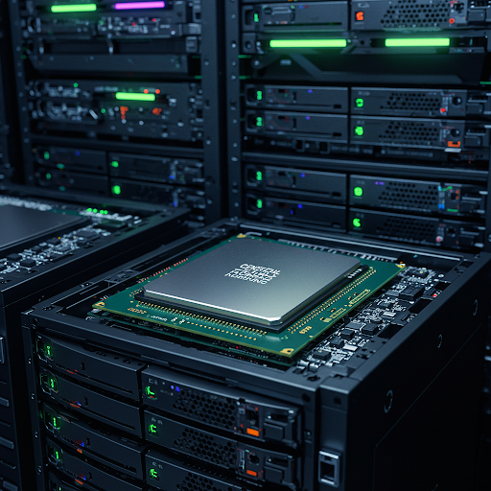
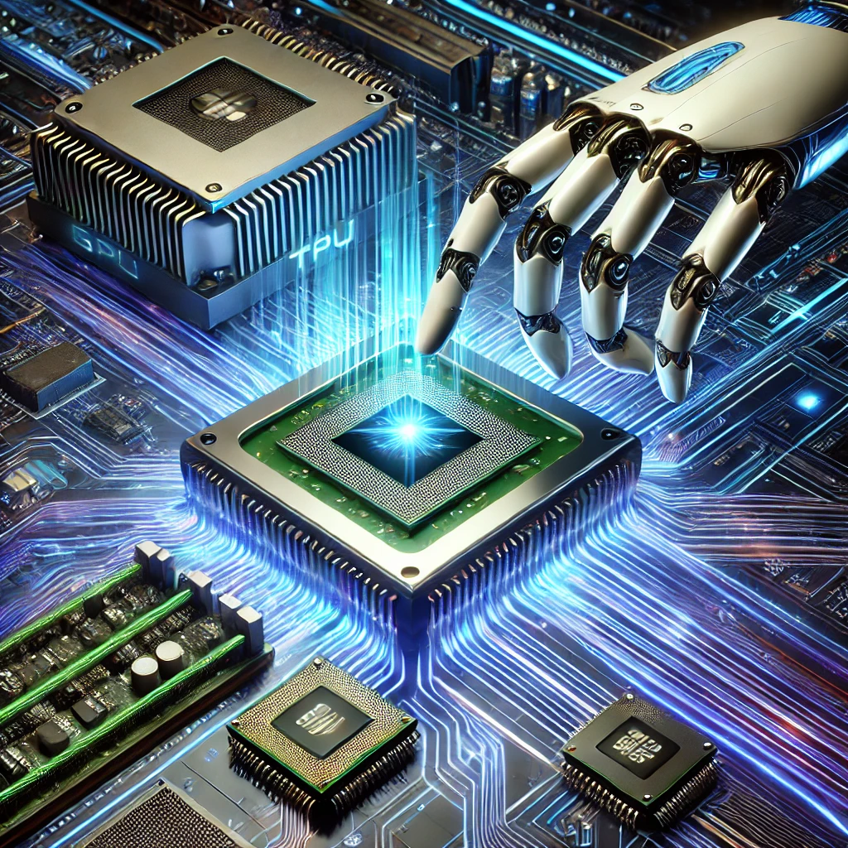
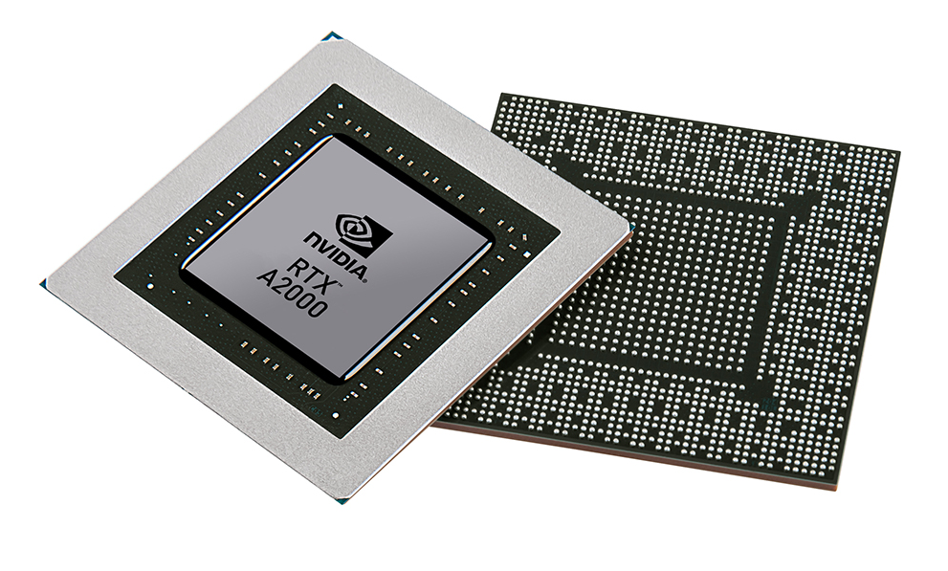


Christof Teuscher
ECE 410/510: Hardware for AI and ML
Week 6: Recap, outlook, and reminders
Portland State University
Department of Electrical and Computer Engineering (ECE)
www.teuscher-lab.com
teuscher@pdx.edu

Slide 2
What did you learn last week?

Slide 3
Recap
No free lunch theorem (no algorithm consistently outperforms random search or any other algorithm).
TPU (matrix multiplication + activation unit)
Systolic array
Mapping a neural net on a systolic array
Transformers (encoder, decoder): main operations
NVIDIA transformer engine: dynamically adjusts precision

Slide 4
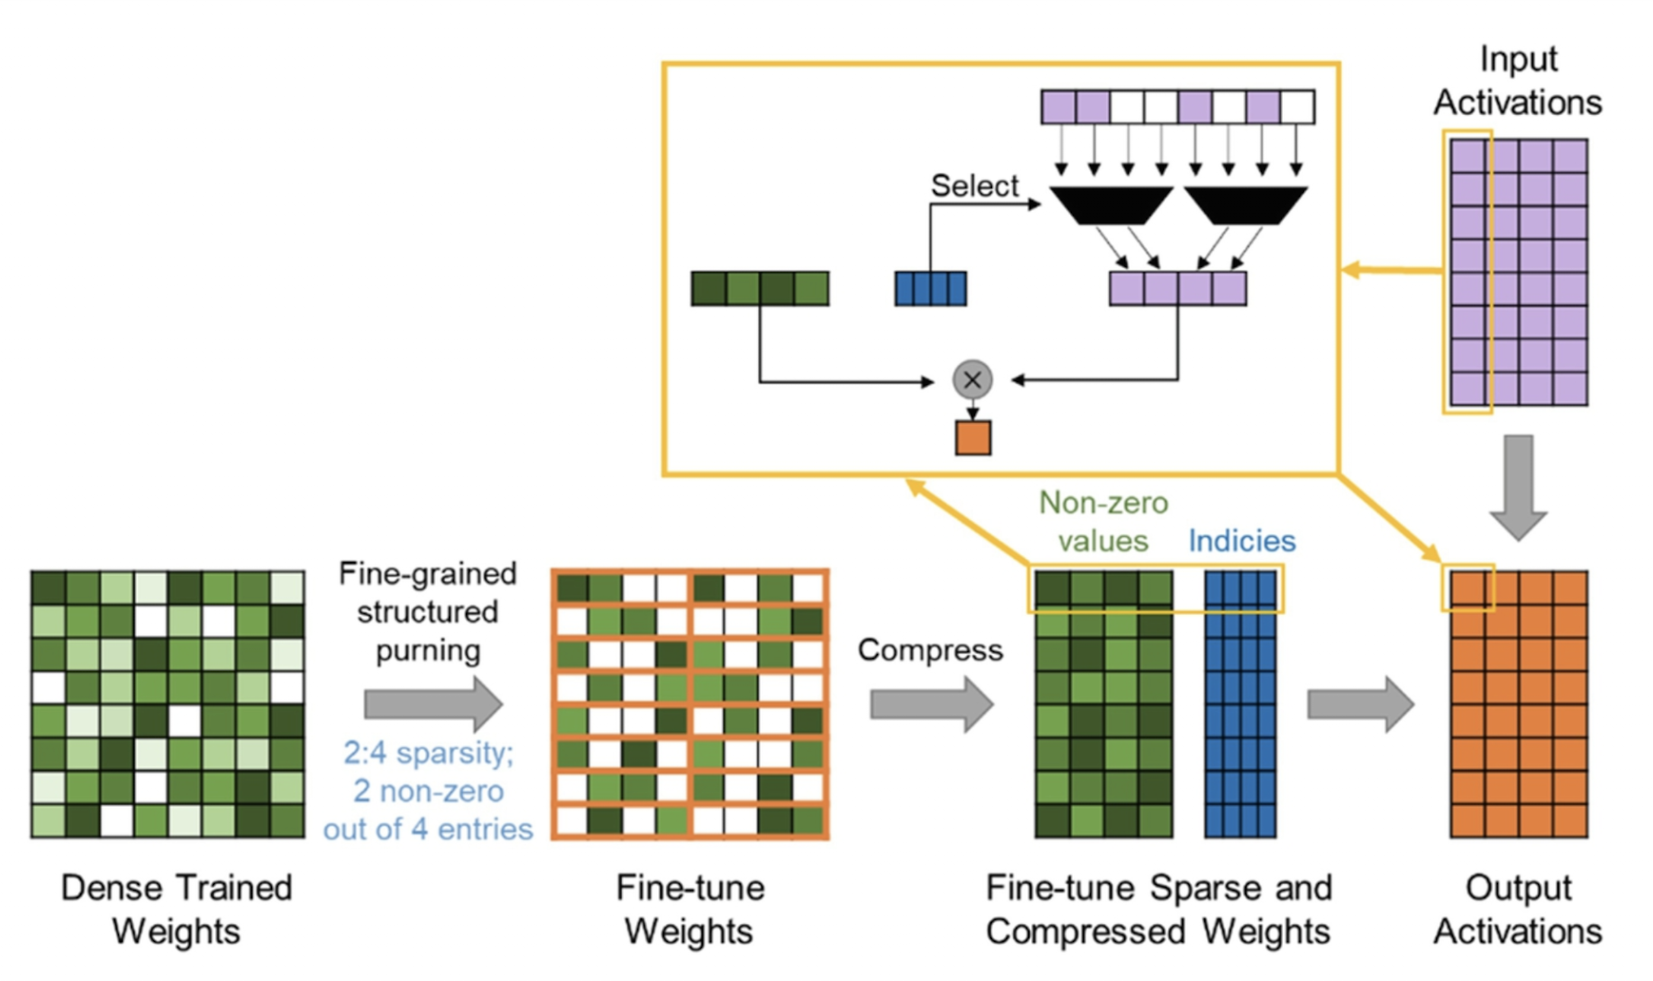
Pruning
Mishra et al.

Slide 5
Week | Monday | Wednesday (Codefest)
2 | HW/AI/ML overview + codesign overview | Start main project: pick workload, start analysis, benchmark, …
3 | GPU architecture and programming for AI | Drafting a HW architecture, creating a model
4 | Deep neural networks on GPUs | Coding HW description
5 | Transformers on GPUs | First simulation + refinement
6 | In-memory computation | Improving initial design
7 | Neuromorphic chips: TrueNorth, Loihi, Akida | Simulation + refinement
8 | Neuromorphic computing with mem-devices | Synthesizing design + benchmarking
9 | Hardware accelerators for embedded systems | Final improvements
10 | Emerging technologies and future directions | Final tests, validation, verification, benchmarking
Memorial Day

Slide 6
This week
Monday
Ways to accelerate an algorithm
Transformers: to spike or not to spike
In-memory computing
Wednesday
Codefest #6: Rinse and repeat?

